Slide 1

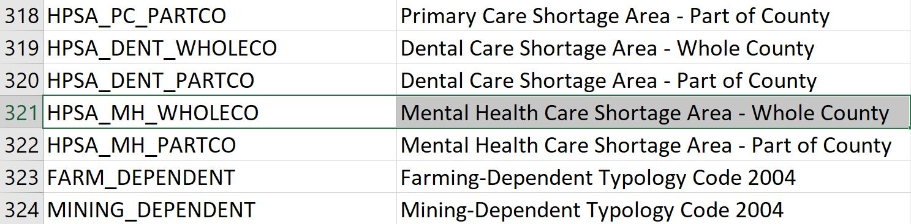
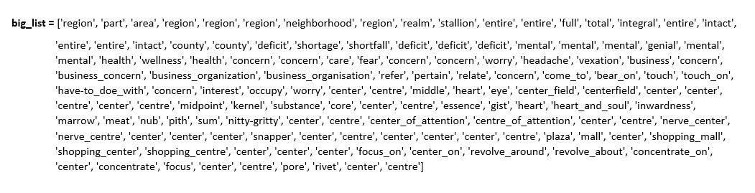
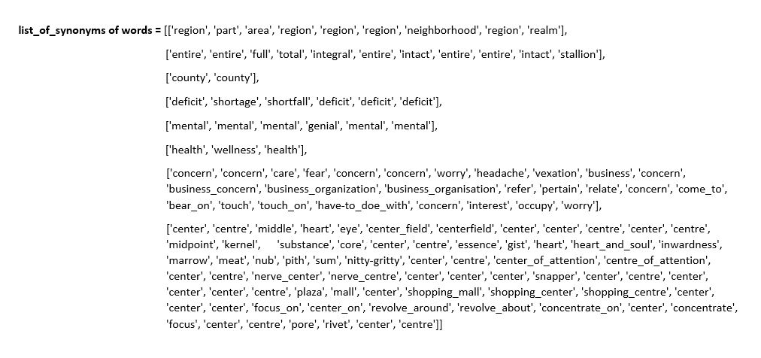

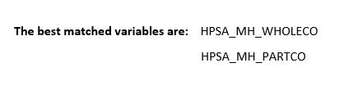
Natural Language Processing-Assisted Data Search
Pradip Lamsal, Susan Mengel, Mario Alberto Pitalúa Rodríguez
Introduction
Need for Smart Search Systems
Paradigm has shifted: Today, it is difficult to search for a particular data not because there is too little information, but because there is too much of it
NLP and other branches of AI can help tackle this problem by enabling machines to understand, interpret, and manipulate human language
Efficiently designed systems can save time and guide users to their destination in the sea of information
The Exposome project, contains over 20,000 variables about U.S. health from the 1940s to 2015
Searching intended variables manually is not possible
We employ Natural Language Processing in this project to guide users toward their intended variables based on their search phrases
Although some work have been done in areas like data warehousing which entails processing and analyzing integrated data from multiple sources, not much has been done to help users find their intended variables in large repositories
Businesses and agencies have developed custom-applications to assist users in searching for variables from their databases, but the systems are not “smart” in that the users have to match their search keywords with the exact words in their intended variables
It is the goal of our team to develop a search platform where researchers can quickly find their intended variables in the Exposome database based on some search phrases which may be exact or similar to the variable description
Methods and Techniques
This system employs the concepts and tools of Natural Language Processing to parse the user input and extract the synonyms of the words in the user’s search phrase.
Every search keyword in the user input, including their synonyms, will be compared against the words present in the description of the variables in the database that stores the intended variable.
As a result, the system will suggest a list of variables whose descriptions match with the user input the best.
For example, consider a scenario where a user wants to search for the percentage of area of an entire county with shortage of mental health care centers.
In this case, the user provides some search phrase like “region of an entire county with deficit mental health concern centers.”
As a result, among others, the system displays the variable named “HPSA_MH_WHOLECO” with the description “Mental Health Care Shortage Area - Whole County,” since this description best matches the search phrase provided.
The intermediary processes that take place before the system displays this variable can be broken down into these steps:
The words in the search phrase such as “of,” “an,” and “with” will be considered as stopwords (words that do not add much to the meaning of the phrase) by the system and will be discarded.
For every remaining word in the search phrase, the system generates a list of synonyms of the words using the Princeton University’s machine-readable lexical database—Wordnet.
The system now creates a “big list” of words that stores every non-stopword in the search phrase and their synonyms.
The system then picks every word in every variable of the database and checks to see if it is present in the “big list.”
While iterating through the 321st variable named “HPSA_MH_WHOLECO” in the database, system finds the word “Mental” in the variable description column which is present in the “big list,” so it assigns one point to the variable.
Similarly, it also finds the remaining words in the variable description that are contained in the “big list,” namely: “Health,” “Care,” “Shortage,” “Area,” “Whole,” and “County.”
So, altogether, the variable collects 7 points, which, divided by the total number of words in the user search phrase excluding the stopwords, 8, gives 0.875 or 87.5%.
This is greater than the set 50% threshold, so the system displays this variable together with other variables which similarly cross the threshold.
Conclusion
We develop a system to search for a variable in the Exposome database based on the user input using Natural Language Processing. The system successfully displays a list of potential matches which also contains the target variable.
There are still some areas that need to be improved. For example, more filters need to be created to accommodate the incomplete or shortened words in the database variable description such as “w/” for “with”, “Gen.” for “General”, “Pop.” for “population,” etc.
With these improvements and more research, this system can be scaled up to build recommender systems that can smartly suggest items in their databases based on the user’s input.

